Slide 1


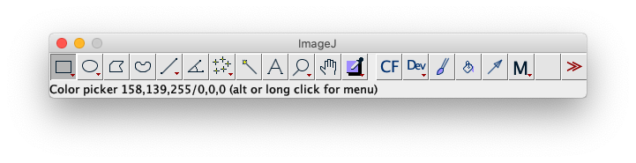
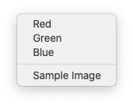
Customizing ImageJ
Robert Haase
Based on Material from
Nicolas De Francesco (IMBICE) and
Jerome Mutterer (IBMP)
License: CC-BY 4.0

Slide 2
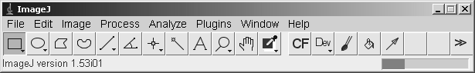
Customizing ImageJ
Menus
Custom tools
Based on Material from Jerome Mutterer (IBMP)
License: CC-BY 4.0

Slide 3
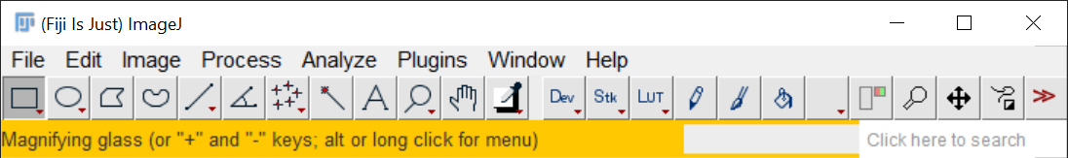
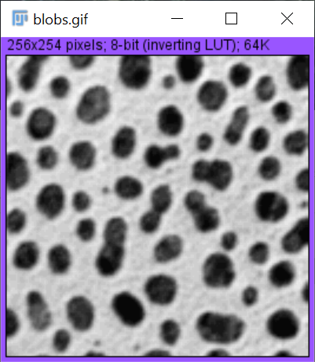
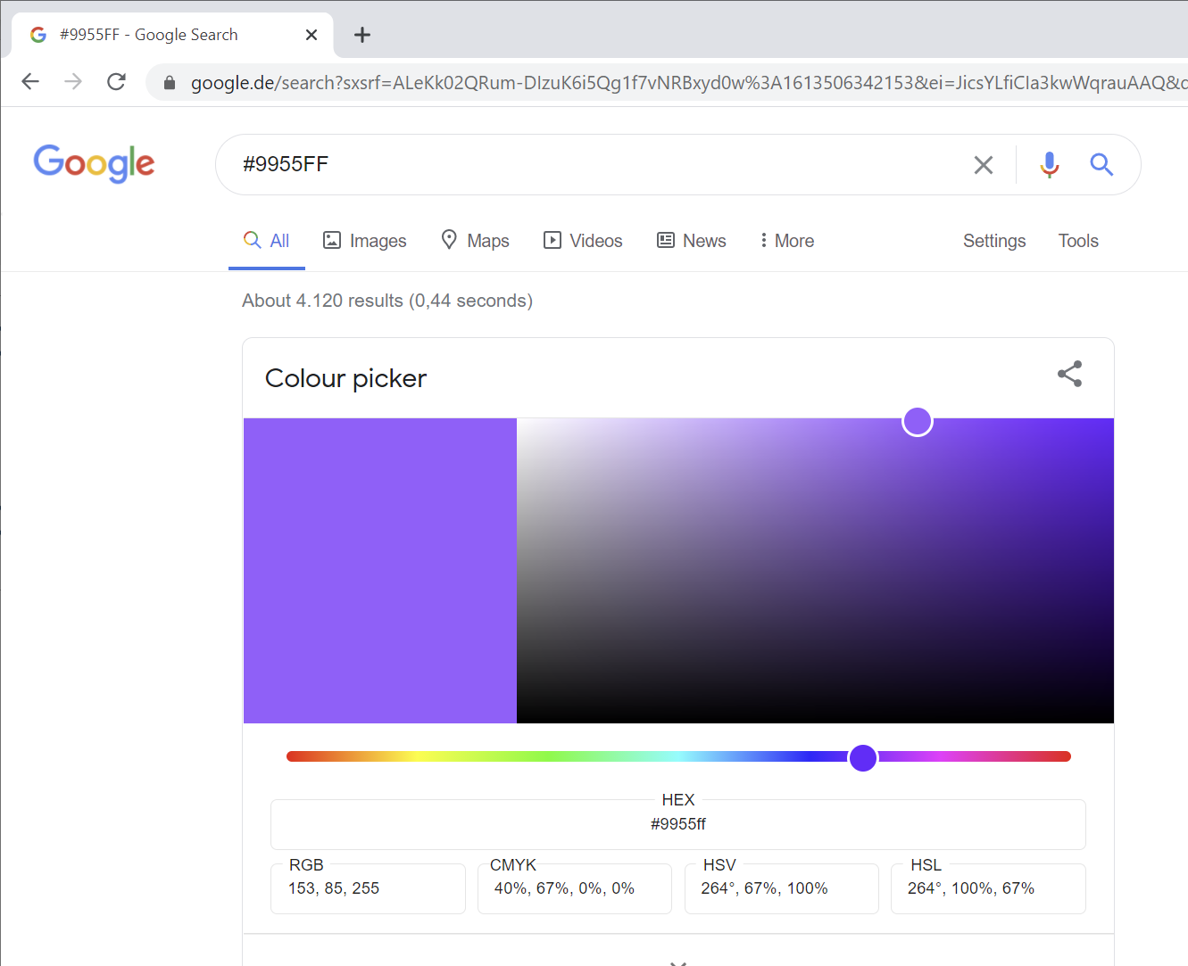
Colors
Change the color of the status bar
run("Alert ", "object=Status color=Orange duration=2000");
Change image frame colors
run("Alert ", "object=Image color=#9955FF duration=0");
Time in milliseconds
Permanent

Slide 4
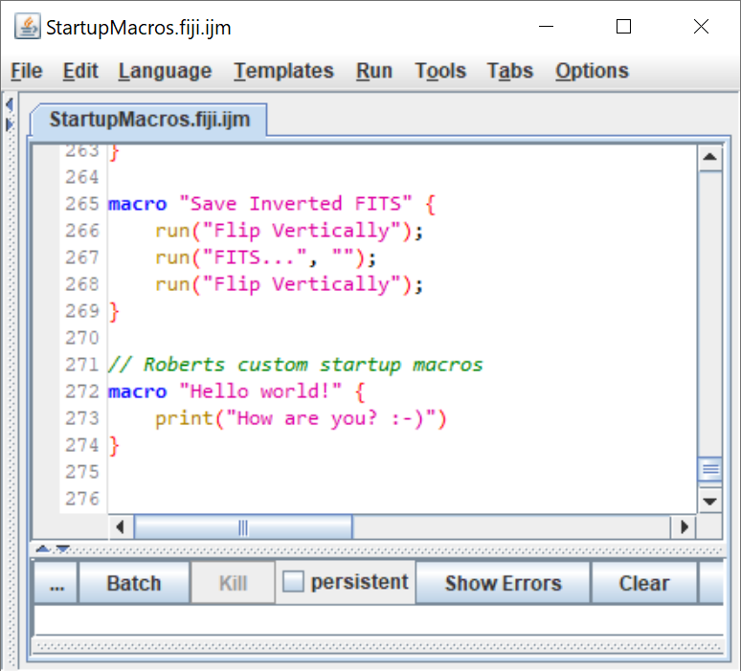
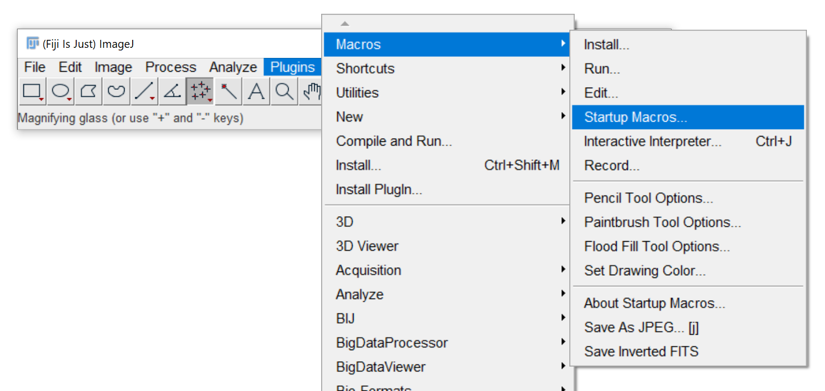
Customizing menus
Edit startup macros to add new menu entries

Slide 5
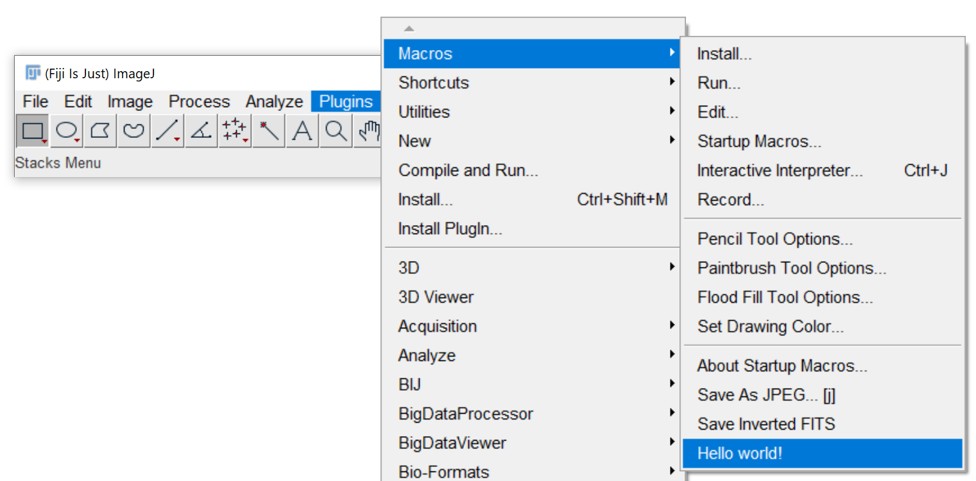
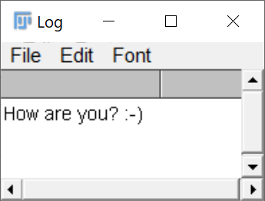
Customizing menus
Edit startup macros to add new menu entries

Slide 6
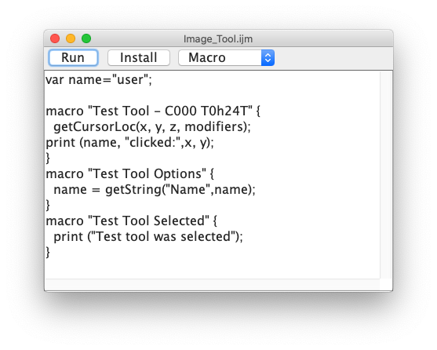
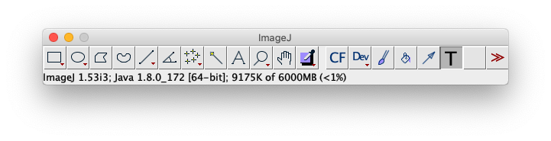
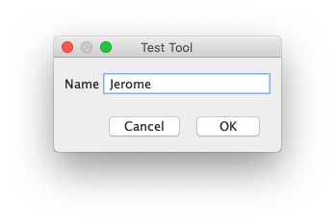
Custom Tool buttons
You can add custom tool buttons to the toolbar
Image Tools end with “Tool”
Action tools end with “Action Tool”
https://gist.github.com/mutterer/3936686a412732433c6a22b2286049da
Based on Material from Jerome Mutterer (IBMP) License: CC-BY 4.0
See also: https://imagej.nih.gov/ij/developer/macro/macros.html#tools

Slide 7
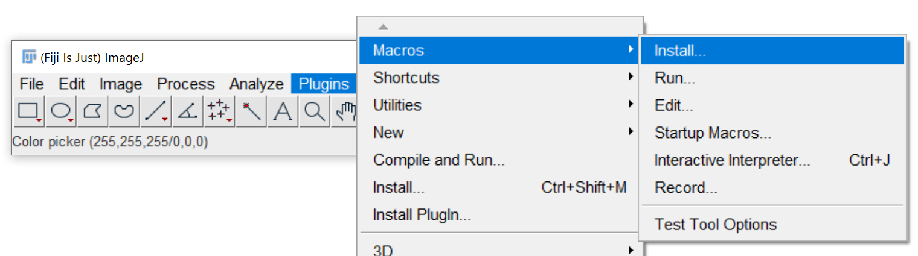
Custom Tool buttons
You can add custom tool buttons to the toolbar
Image Tools end with “Tool”
Action tools end with “Action Tool”
Installation
Save the macro first!
Based on Material from Jerome Mutterer (IBMP) License: CC-BY 4.0
See also: https://imagej.nih.gov/ij/developer/macro/macros.html#tools

Slide 8
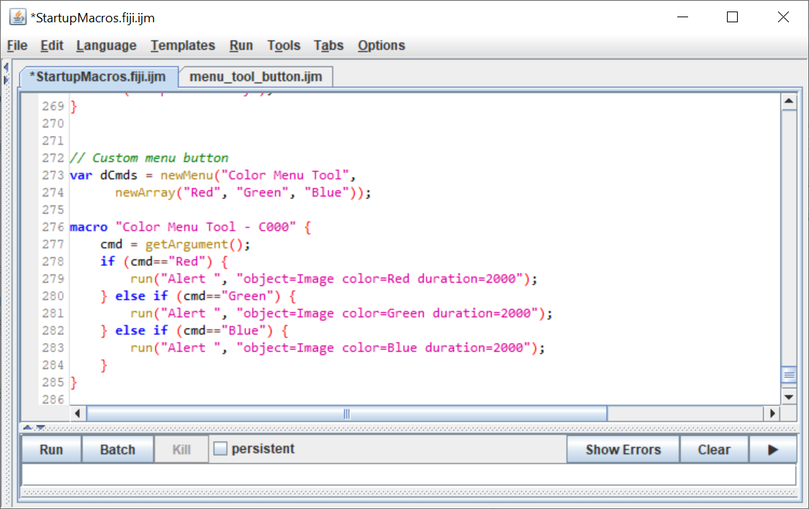
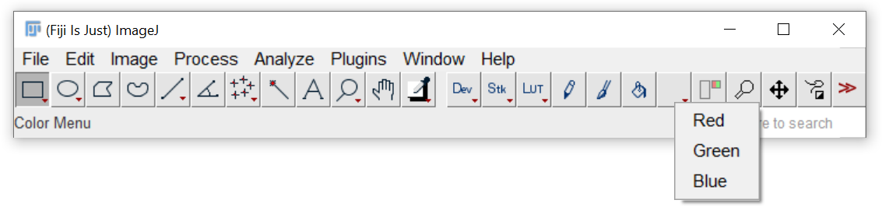
Custom Tool button menus
Add menus to tool buttons for easy access to complex functionality
menu_tool_button.ijm
https://imagej.nih.gov/ij/developer/macro/functions.html#newMenu
https://imagej.net/developer/macro/macros.html#icons
Based on Material from Jerome Mutterer (IBMP) License: CC-BY 4.0

Slide 9
Custom Tool Buttons: Demo

Slide 10
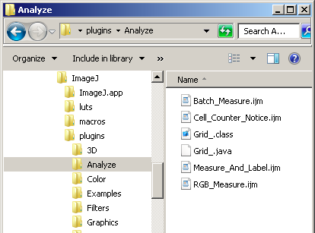
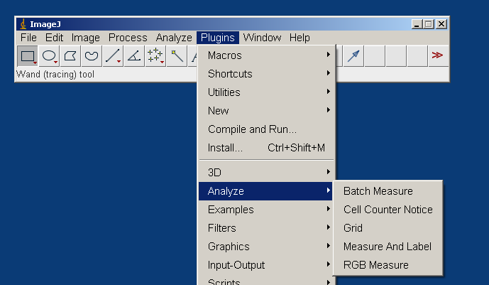
Customizing menus
The Plugins> menu reflects the sub folder structure of the ImageJ/Plugins/ folder.
Important: Only files with an _ in their name are shown.
Based on Material from Jerome Mutterer (IBMP)
License: CC-BY 4.0

Slide 11
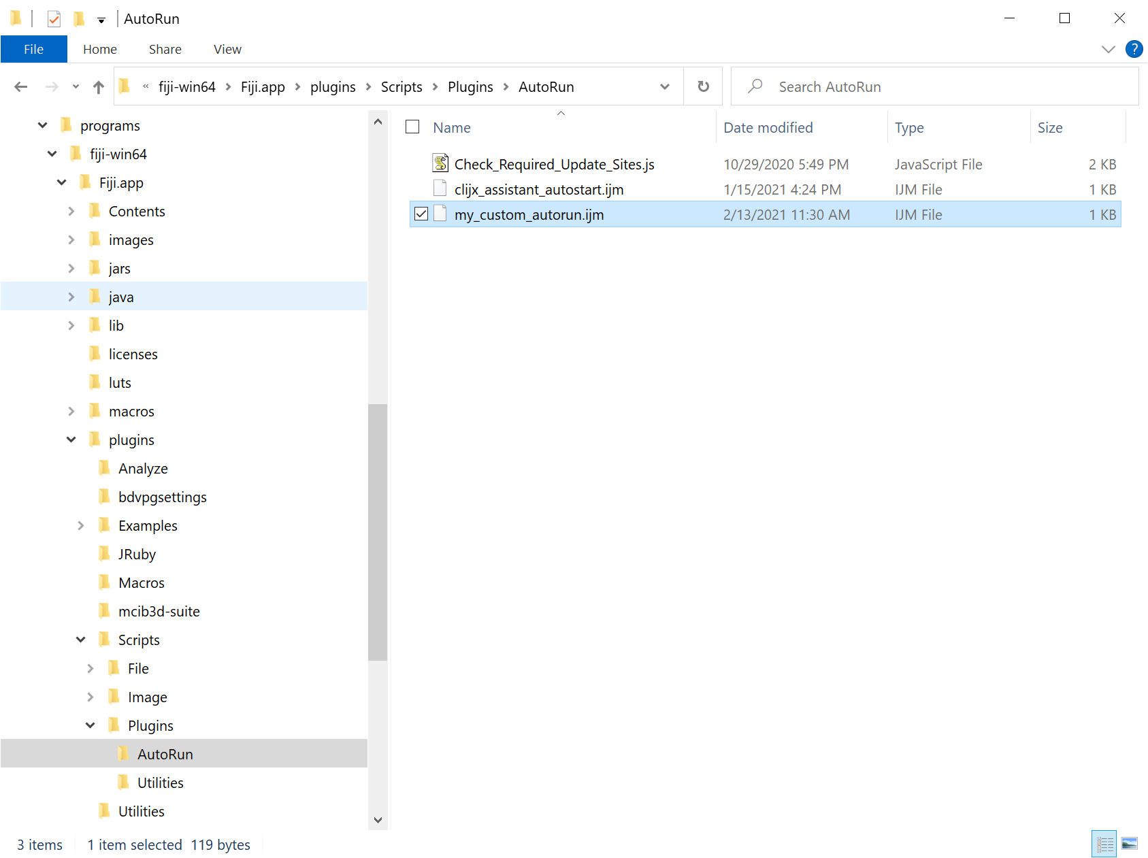
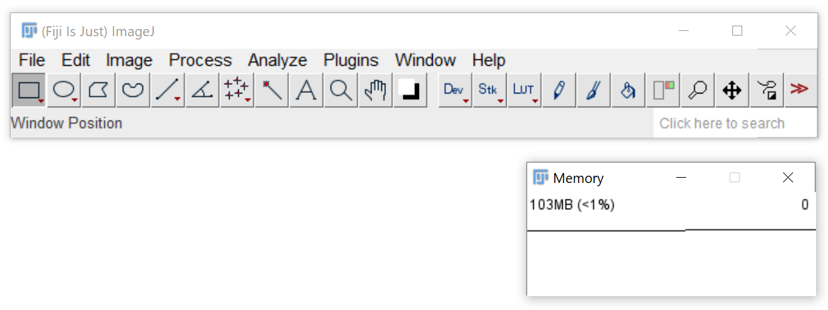
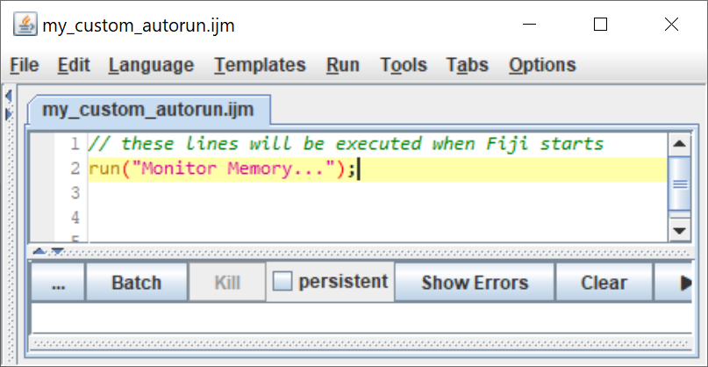
AutoRun
Macros in the Fiji.app/macros/AutoRun/ and Fiji.app/plugins/scripts/plugins/autorun folder will be executed at startup.

Slide 12
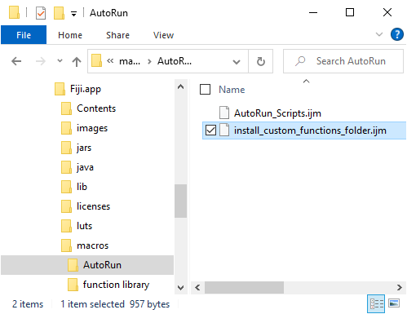
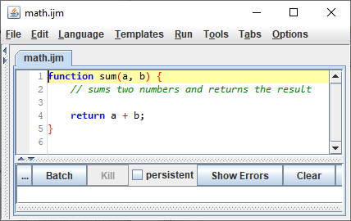
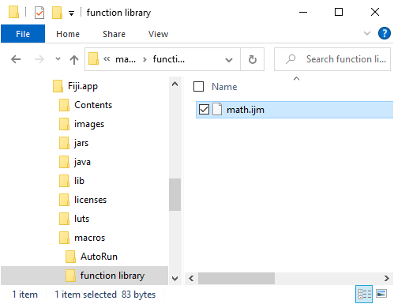
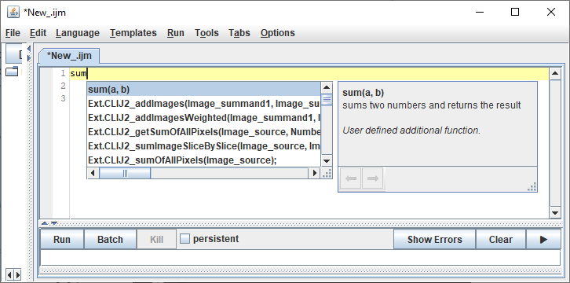
Custom functions
Collect custom functions for reuse in a custom folder
Thanks to Nicolas De Francesco (IMBICE)
https://forum.image.sc/t/auto-code-completion-for-ij-macro/11642/95

Slide 13
Customizing Menus: Demo

Slide 14
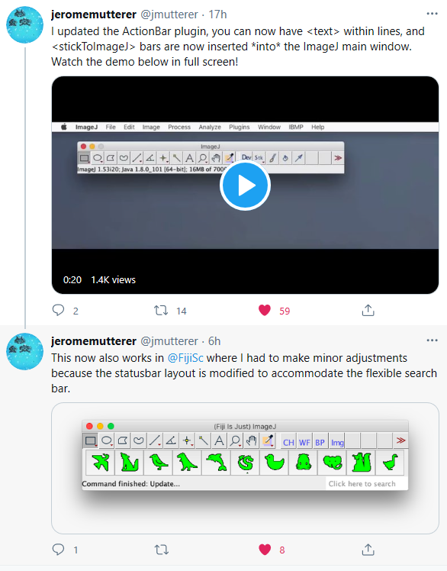
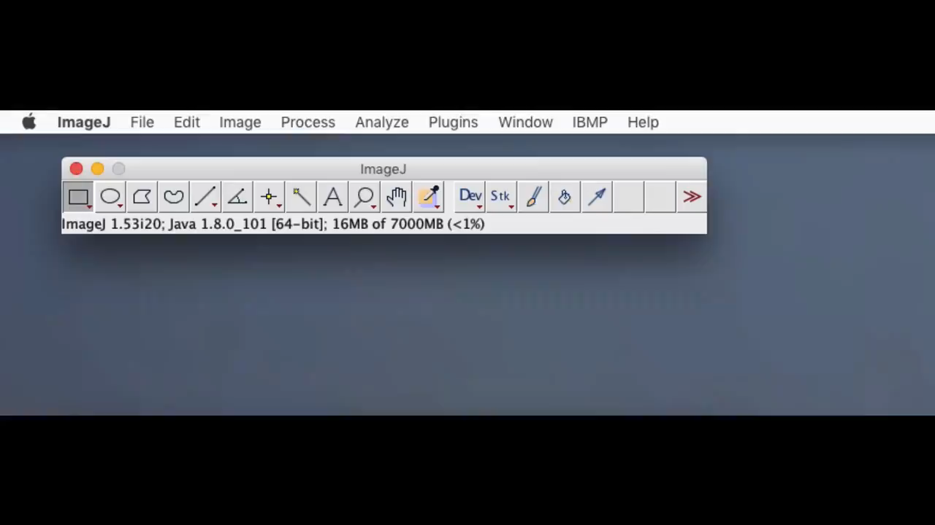
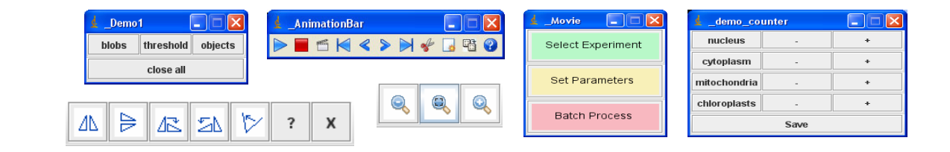
ActionBars
ActionBars allow you to have additional tool buttons
https://twitter.com/jmutterer/status/1363971956861714432?s=20
Based on Material from Jerome Mutterer (IBMP) License: CC-BY 4.0
https://docs.google.com/presentation/d/194pZLgxHIlyOXorIYPvRE-KZSiXpdfhyL6f7UwmAG0o/edit#slide=id.p

Slide 15
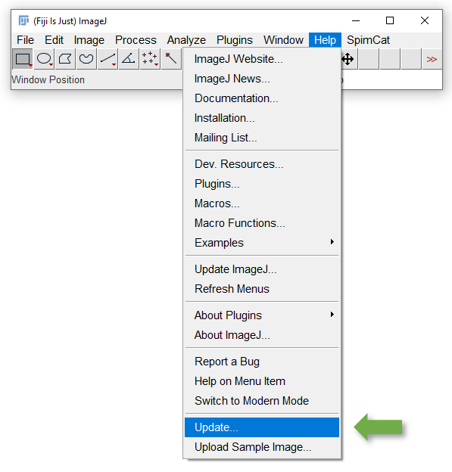
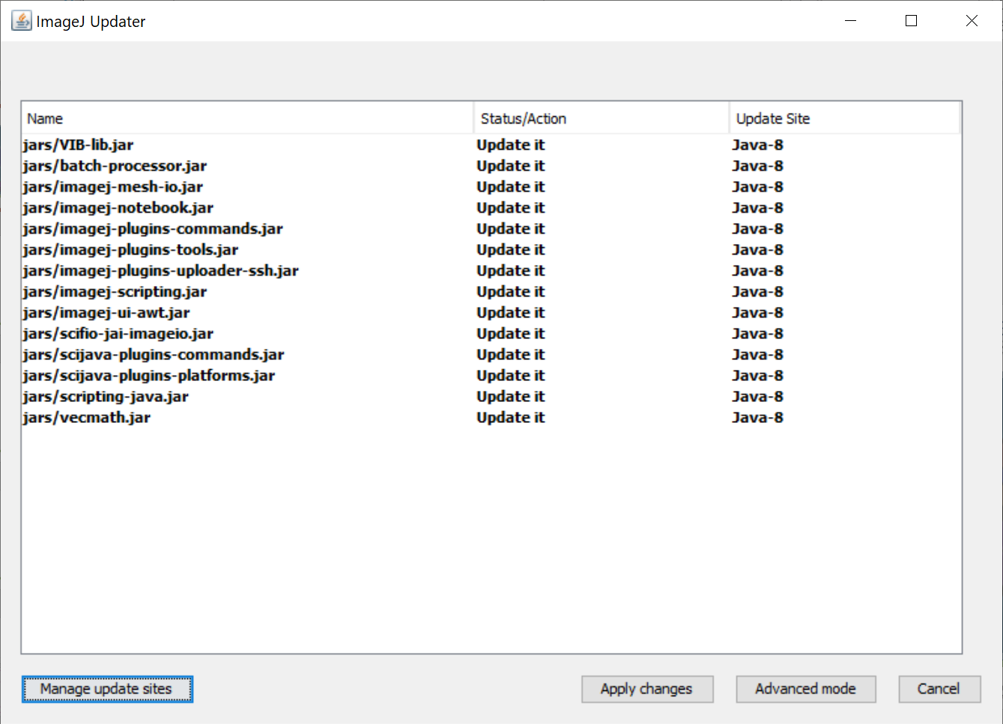
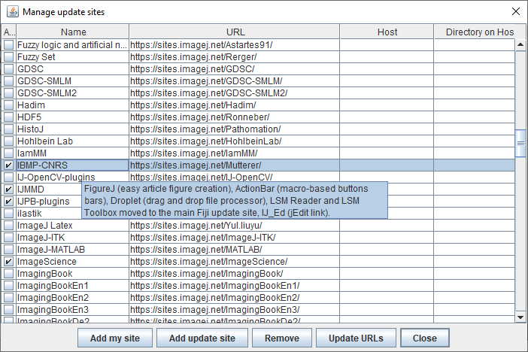
Installation
Available via the IBMP-CNRS update site

Slide 16
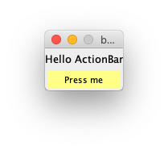
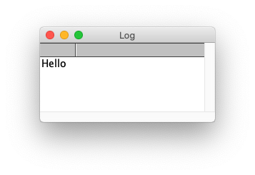
ActionBars
The macro calls the Action Bar plugin with itself as an argument
The Action Bar plugin renders the panel
<text> also accepts html syntax
Duplicate <line>..</line> for multiple lines
Duplicate <button> section for multiple buttons
A button runs the code inside <macro>..</macro>
run("Action Bar","/plugins/ActionBar/bar_name.ijm"); exit();
<text>Hello ActionBar
<line>
<button> label=Press me bgcolor=#FFFF88 arg=<macro> print("Hello"); </macro>
</line>
Based on Material from Jerome Mutterer (IBMP) License: CC-BY 4.0
https://docs.google.com/presentation/d/194pZLgxHIlyOXorIYPvRE-KZSiXpdfhyL6f7UwmAG0o/edit#slide=id.p

Slide 17
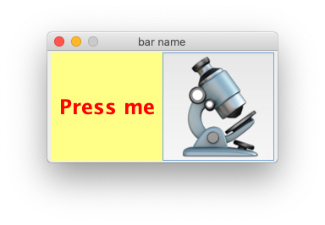
ActionBars
Button properties
label=... the button’s text label (also takes html)
bgcolor=#ffff88 the button’s background color
icon=... the button’s face icon
arg=... the button’s action
arg=<macro>... </macro> multi-line
arg=<tool>... </tool> multi-line tool
arg=<hide> toggle ImageJ main window
arg=<close> close this bar
<button> label=<html><h1><font color='red'>Press me</font></h1></html> bgcolor=#FFFF88 arg=<macro> print("Hello"); </macro>
<button> icon=bar_name/microscope.png arg=<macro> print("Hello"); </macro>
Based on Material from Jerome Mutterer (IBMP) License: CC-BY 4.0
https://docs.google.com/presentation/d/194pZLgxHIlyOXorIYPvRE-KZSiXpdfhyL6f7UwmAG0o/edit#slide=id.p

Slide 18
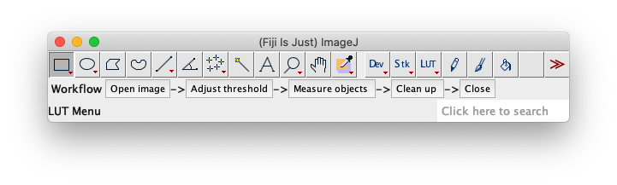
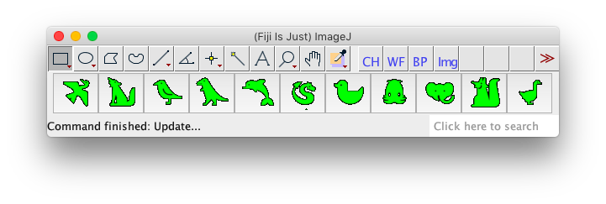
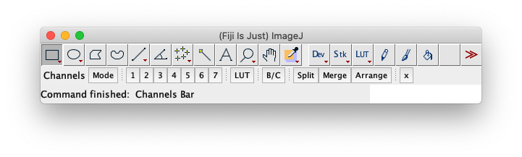
ActionBars
Embedded ActionBars
using <stickToImageJ>
Based on Material from Jerome Mutterer (IBMP) License: CC-BY 4.0
https://docs.google.com/presentation/d/194pZLgxHIlyOXorIYPvRE-KZSiXpdfhyL6f7UwmAG0o/edit#slide=id.p

Slide 19

ImageJ Macro Markdown
Robert Haase
Notes:
Good morning everyone, my name is Stephan Grill, and I am excited to present to you our Cluster of Excellence Application ‘PHYSICS OF LIFE’ -Klick-

Slide 20
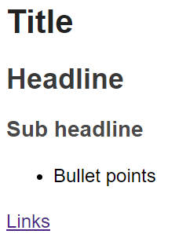
Markdown
Text markup language
# Title
## Headline
### Sub headline
* Bullet points
[Links](https://github.com/haesleinhuepf/imagejmacromarkdown)
https://en.wikipedia.org/wiki/Markdown

Slide 21
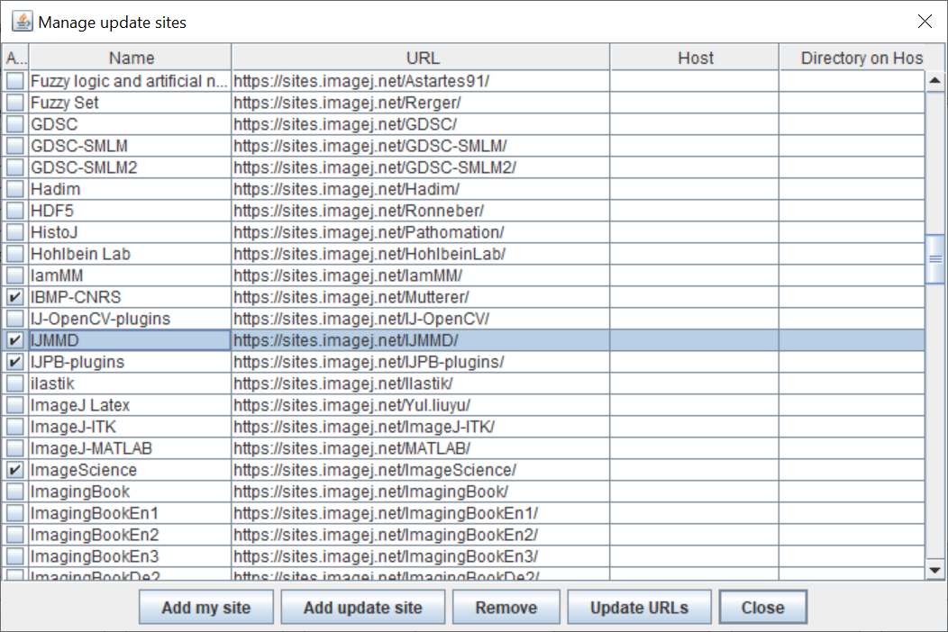
Installation
Available via the IJMMD update site

Slide 22
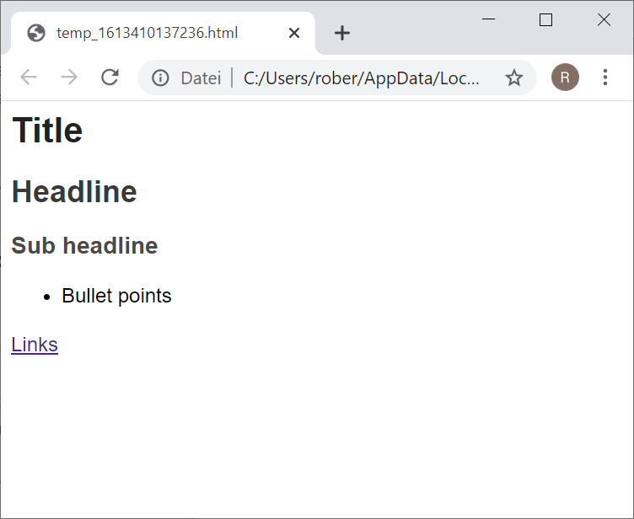
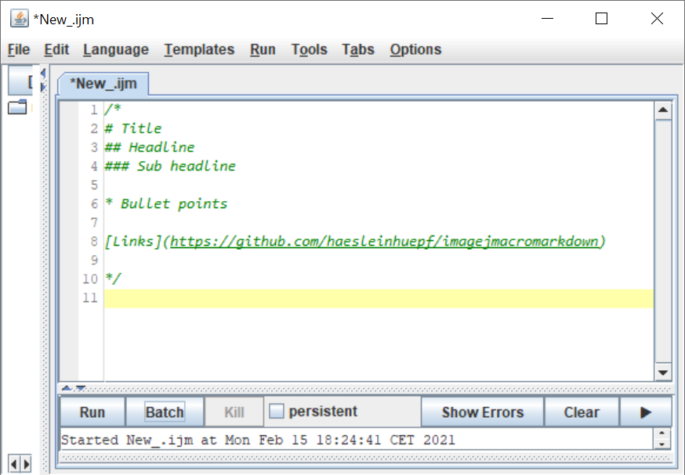
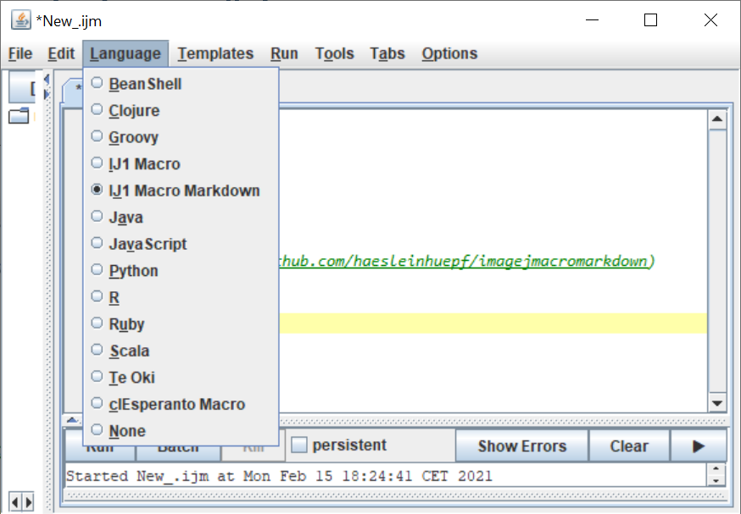
Usage
Enclose markdown in multi-line comments between /* and */
Activate “ImageJ Macro Markdown” language
Run!

Slide 23
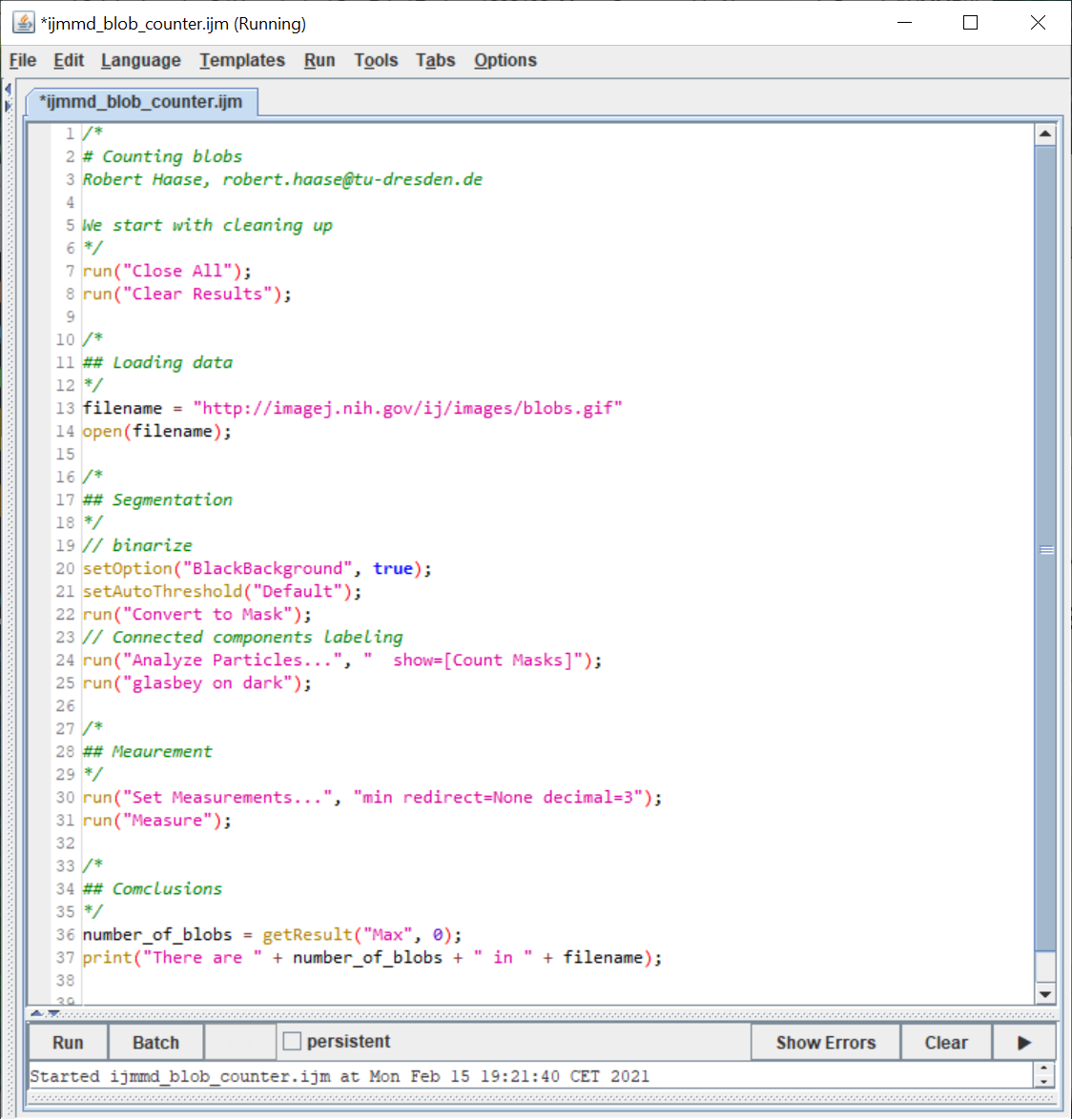
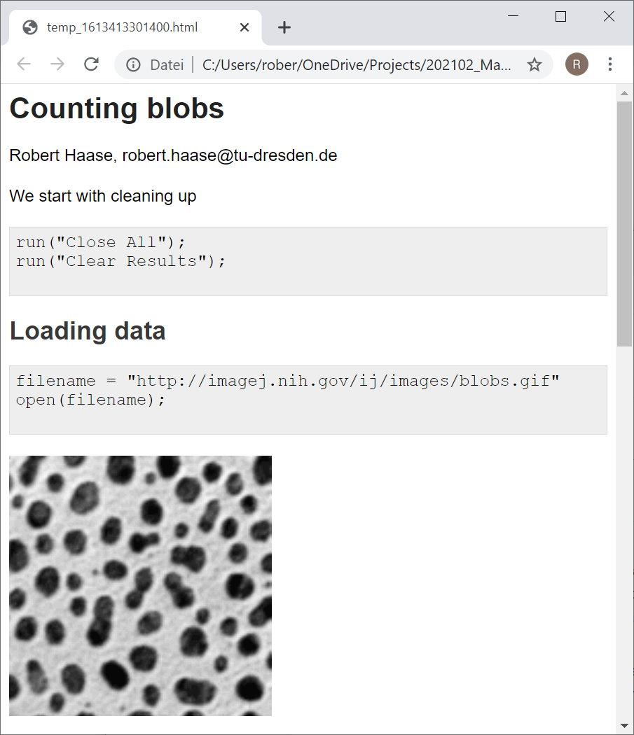
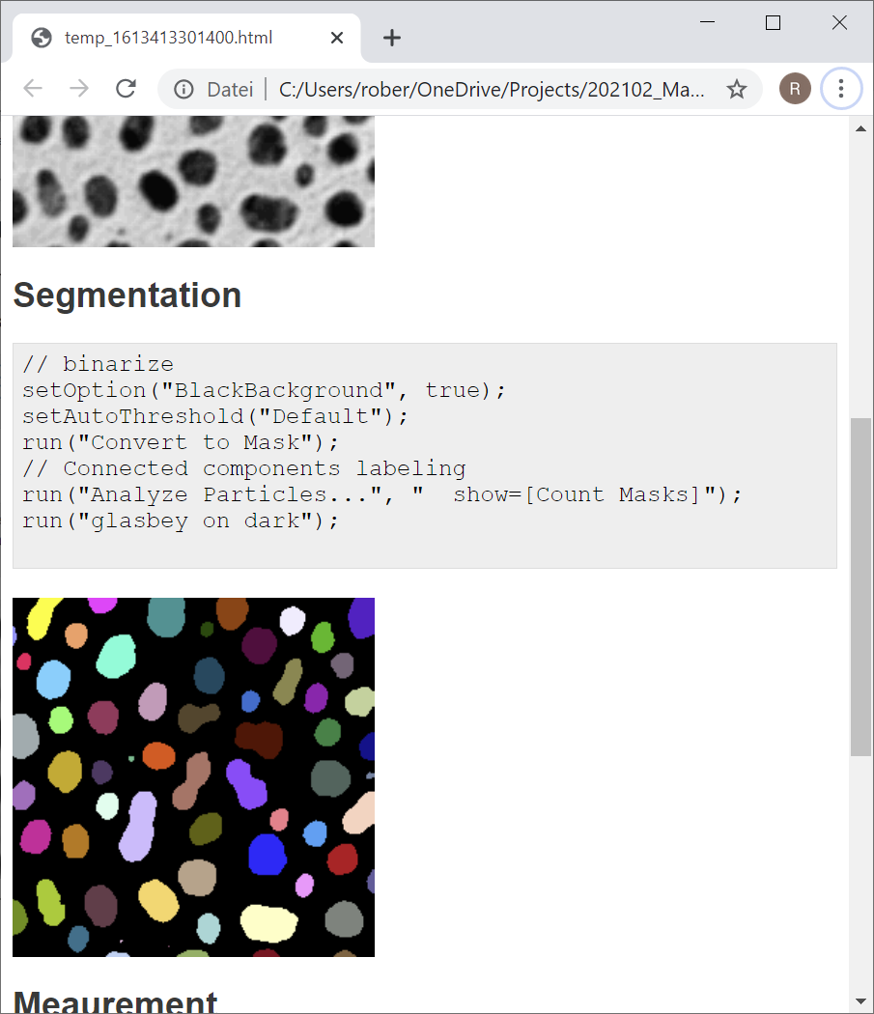
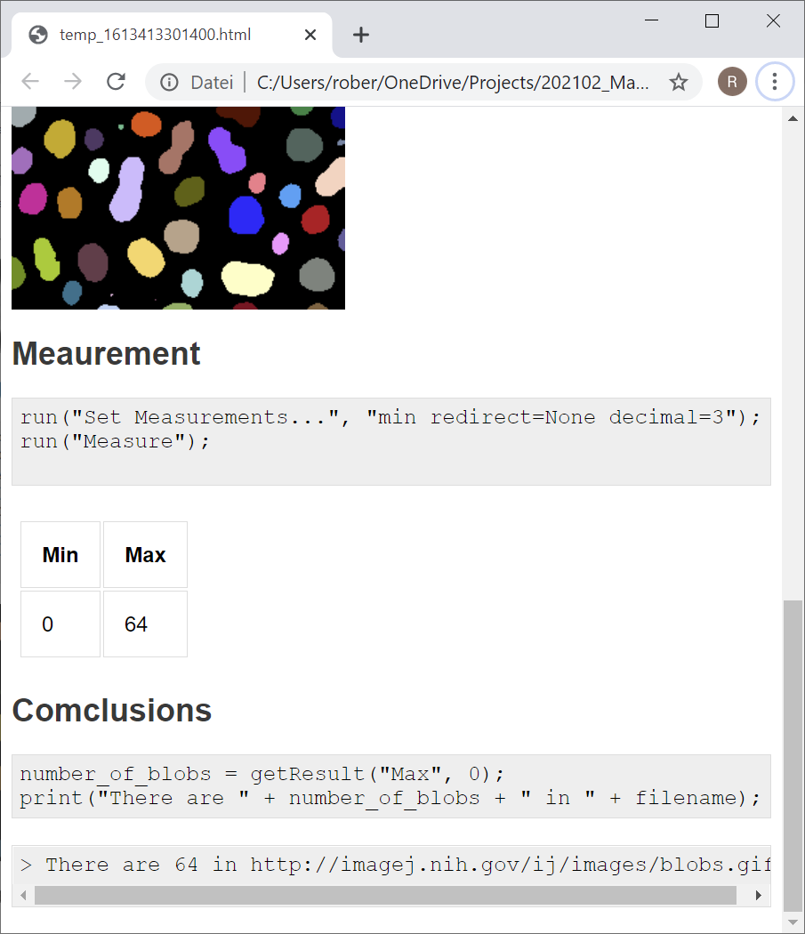
Usage

Slide 24
ImageJ Markdown: Demo

Slide 25
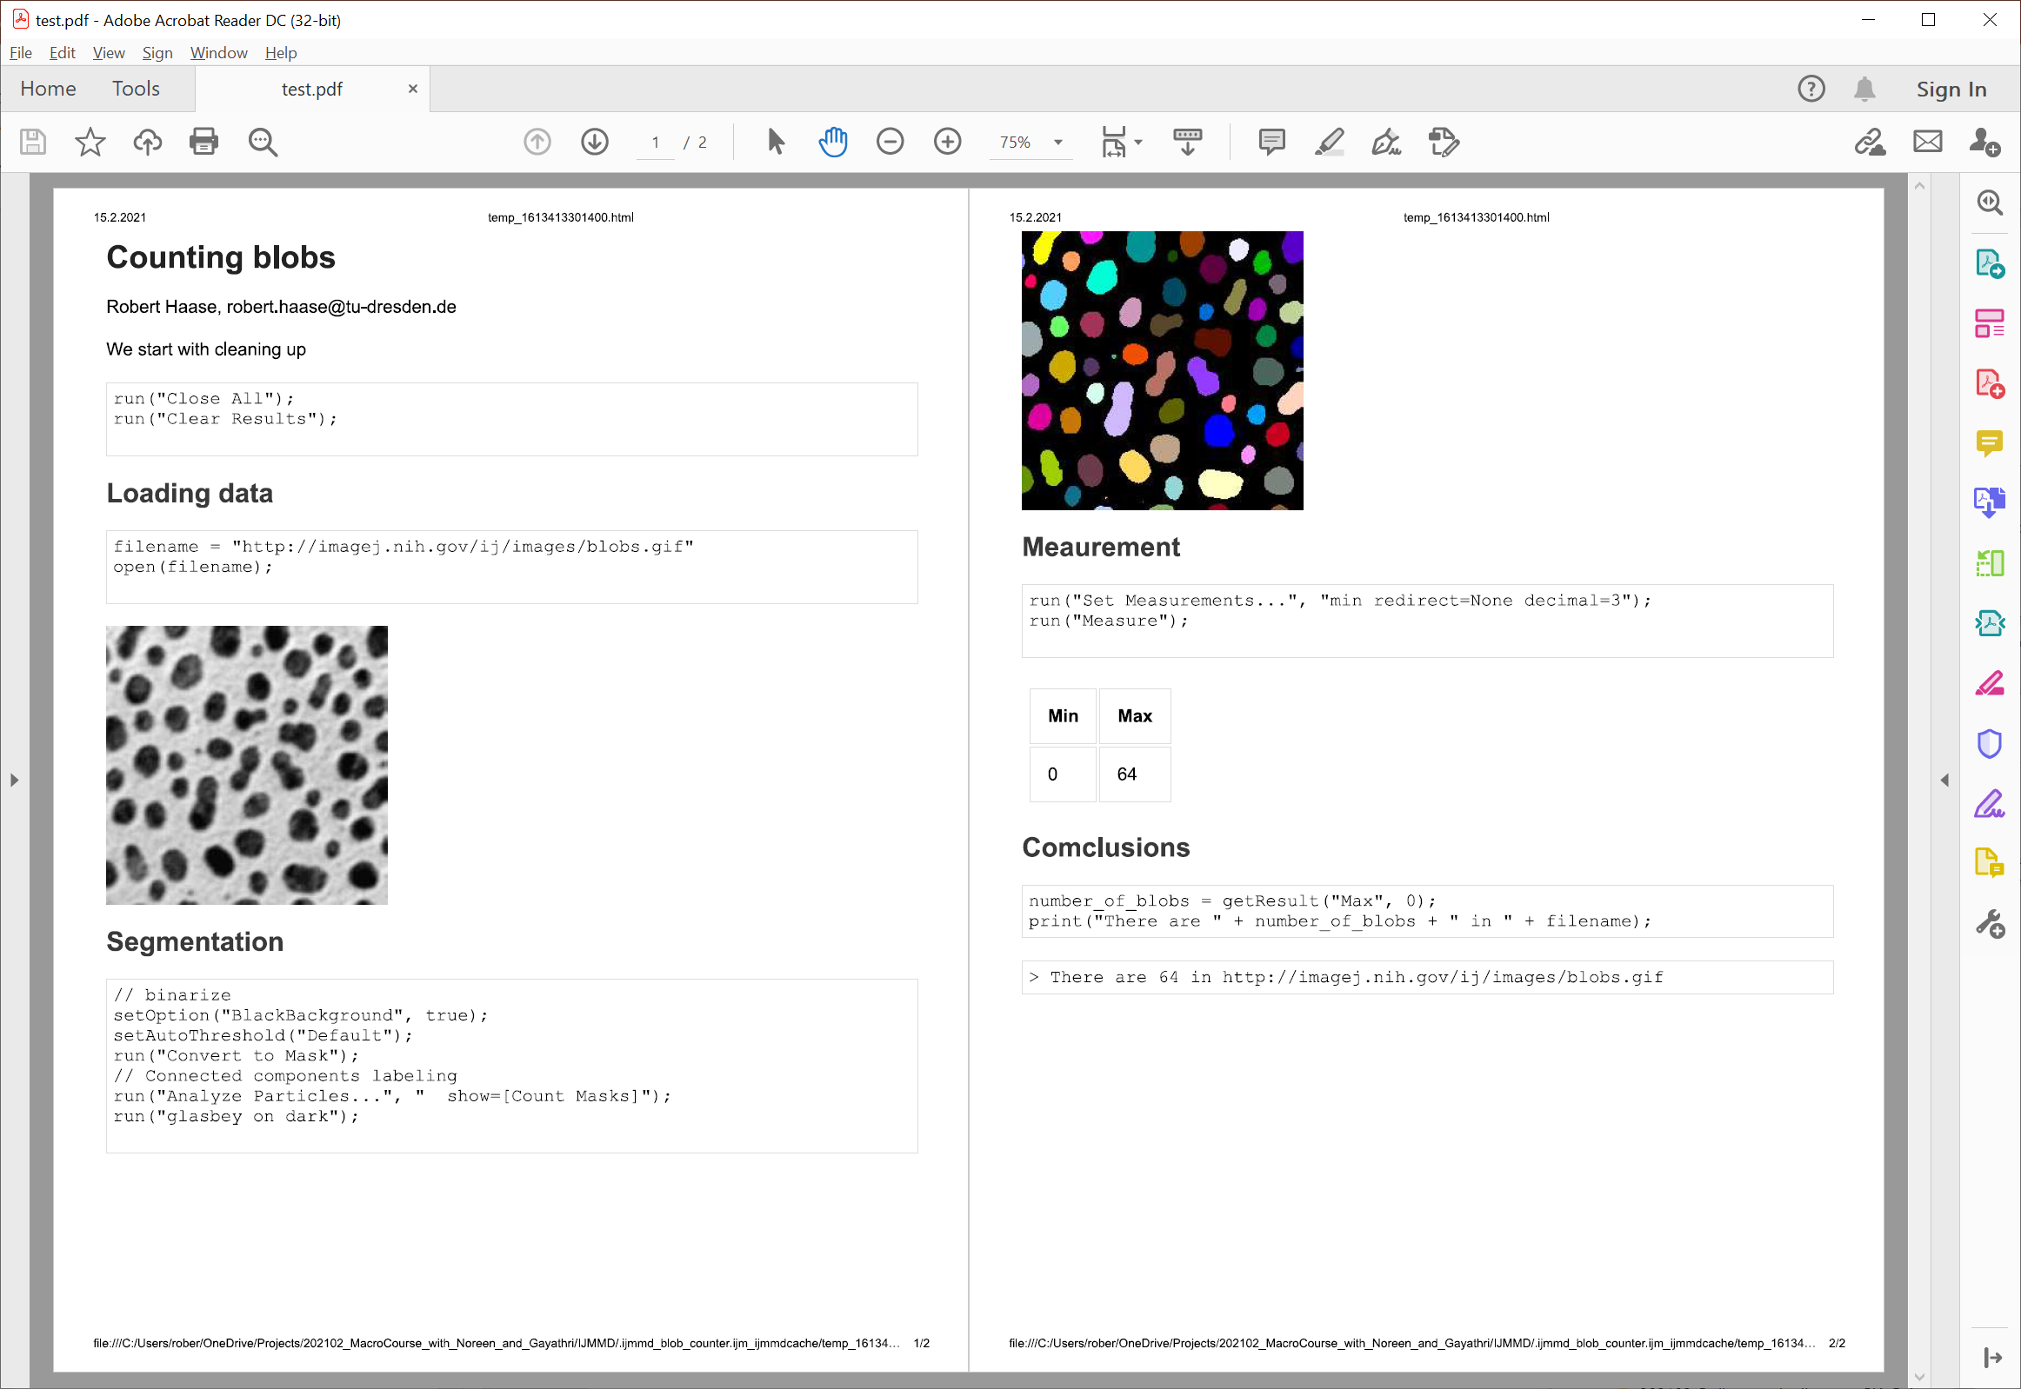
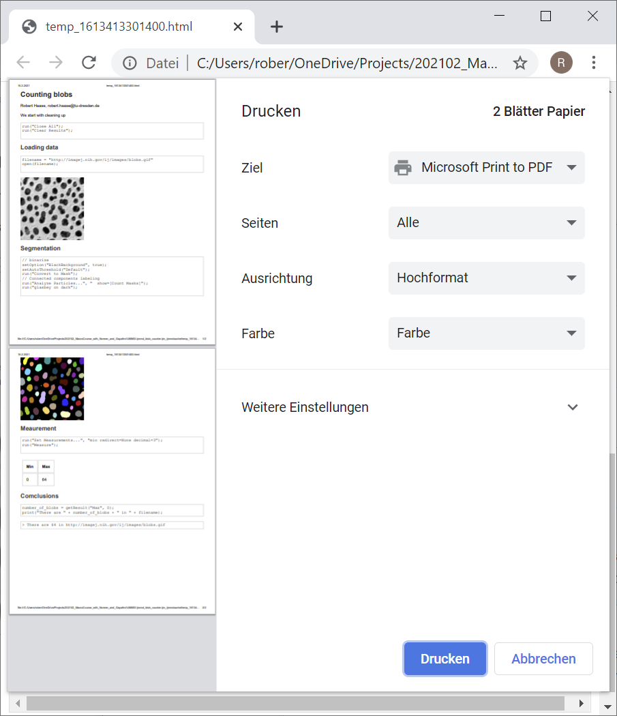
Export PDFs
When your notebook is ready, export a PDF and store it in the project documentation.

